Slide 1
Level Design
CS 4730 – Computer Game Design
Credit: Several slides from Walker White (Cornell)

Slide 2
What does it mean to design a level?
You have to understand the player’s capabilities
Mechanics / actions available to player
Assumption of player skill level
You are laying out the game geography
Location and interaction of challenges
Dynamic features (NPCs)
You are also determining player progression
How does the player progress through the game

Slide 3
focus on each of these…
1. Focus on the player’s capabilities
That’s when we train the player to understand the game’s systems and improve their own skills
2. Focus on player progression
That’s when we focus on storytelling (or the experience overall)
3. Focus on game geography
That’s when we come up with the actual layout

Slide 4
1. Teaching the Game
A player coming into your game falls into one of these categories:
Has no idea how to play the game or any game of this type (complete novice)
Has never played your specific game, but knows the conventions of the genre (some knowledge)
Has played similar games or prequels (domain knowledge)
Has played this specific game before (expert)

Slide 5
1. Teaching the Game - Novice
Someone who has never played your game, nor any other game in the genre
Well, they could read the manual…
Yeah, no. That’s the best way to turn off a player
(Back in the day, manuals mattered… but not really to learn how to play…)
Let’s make some tutorial levels!
Start playing immediately
AND learn while doing it!

Slide 6
The Tutorial Level
Start with your design doc
Remove everything except the simplest core mechanic
Disable numerous actions and interactions
“Dumb down” your game
Add mechanics back in one at a time
You don’t HAVE to add a new mechanic for EACH level
Some take time. This can affect your layouts.

Slide 7
Thomas Was Alone
Let’s look at the first levels of Thomas Was Alone
https://www.youtube.com/watch?v=Qtqe9x4s7LA

Slide 8
Super Mario Bros. 2
Let’s look at the first level of SMB 2

Slide 9
TWA vs. SMB 2
How do these two games compare with how they teach the mechanics to the player?

Slide 10
Goals for today
1. A couple more examples of tutorial / level design
RPG: Ni No Kuni
More Local Design: Play some Mega Man
2. Briefly discuss flow
3. Talk a bit about meaningful choice and game geography
A bunch of examples

Slide 11
PSA: Try to avoid this:

Slide 12
How do more complicated games do it?

Slide 13
2. Focus on Player Progression
Two schools of thought here:
Start very small and build up
Give everything and let the user get a taste of what’s coming
“Finish the first level last.” – John Romero, creator of Doom
Another option: put a lot of content in the tutorial level to encourage replay with different ideas

Slide 14
Doom Hangar
Put everything in first level.

Slide 15
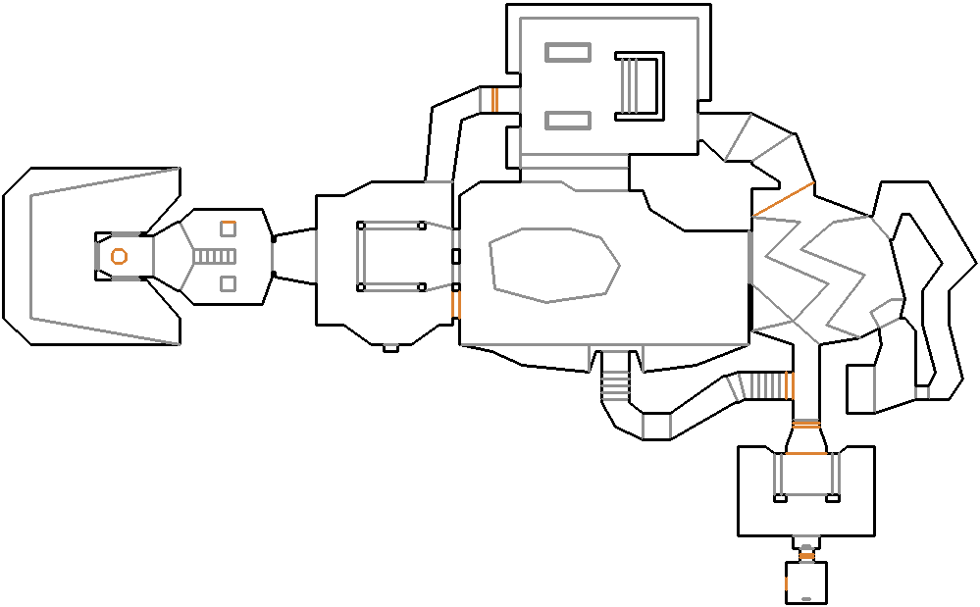
The Hanger - Doom

Slide 16
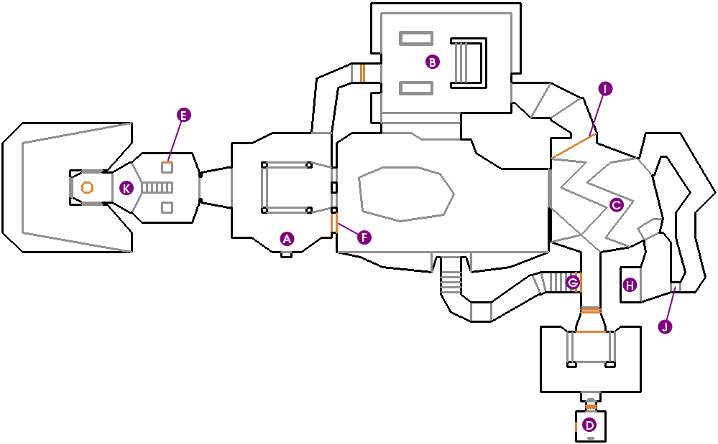
The Hanger - Doom

Slide 17
Upgrading Mechanics
How do we introduce new mechanics one at a time?
Gated by new PCs (Thomas Was Alone)
Item pickups (Metroid, Castlevania: SOTN)
Leveling (many RPGs)
Often treated as a form of training
“Master this thing and then you can have another thing”
Bad end to this: grinding

Slide 18
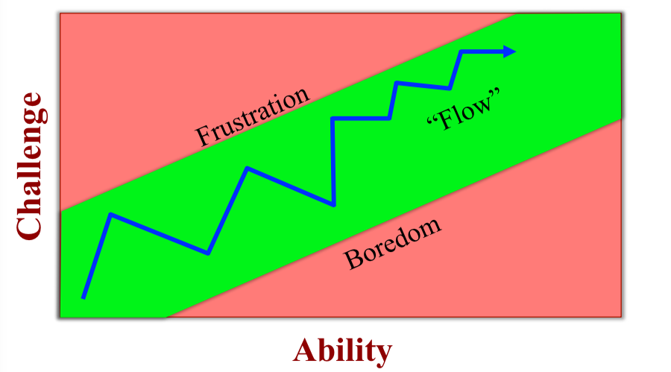
Training and Flow

Slide 19
Enabling Flow
Challenging activity that requires some skill
Physical, mental, or social skill
Without skill => Cannot do it
Goals and Feedback
Player has to know what they are working toward
Constant feedback as to whether the goal is being approached
Have to know if success or failure is achieved (clear win/fail state)

Slide 20
Designing a Tutorial Level
Identify the learning objective
What should the player learn?
Not necessarily the same as beating the level
Identify player assumptions
What should the player know how to do now with the mechanics?
How much skill should the player have?
Storyboard the progress
Note: Puzzle design is the inverse of this

Slide 21
Mega Man
Early Mega Man games do a great job of teaching the mechanics of a level and offering this progression
Let’s check it out:

Slide 22
3. Focus on Game Geography
Games are all about “meaningful choice”
Players need to be able to “own” their playthrough of the game
Choosing a new weapon that +1 better than something with power of 530 already isn’t choice
Choosing to “go high” or “go low” in a level IS choice

Slide 23
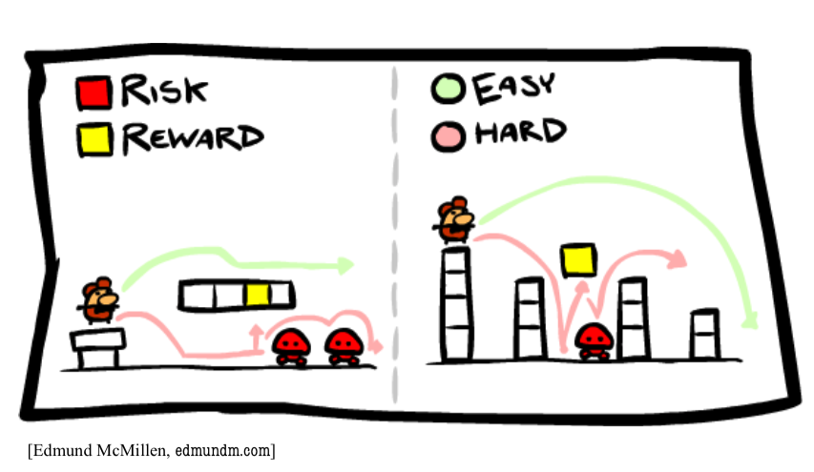
Analysis Paralysis – Risk and Reward

Slide 24
Build up the Level
Design individual challenges
Maybe not quite “set pieces”, but similar
Choose a single obstacle or mechanic or NPC
Figure out where in the level this might occur
This could be a single frame in a storyboard
Combine pieces to make a full level

Slide 25
Super Mario Bros. 3
Level 1-1
http://www.mariouniverse.com/images/maps/nes/smb3/1-1.png
Level 1-5
http://www.mariouniverse.com/images/maps/nes/smb3/1-5.png

Slide 26
Donkey Kong Country Tropical Freeze
Windmill Hills
https://www.youtube.com/watch?v=deuxJxOaYfc

Slide 27
What About Open World Games

Slide 28
BOTW
A couple interesting design things here.
Overall approach: soft guidance
1. Visual landmarks visible from high altitudes
2. Harsh weather prevents certain travel paths
3. Difficult enemies restrict some paths
4. Cutscenes to push player towards major goals

Slide 29
BOTW
1. Visual landmarks visible from high up

Slide 30
BOTW
2. Harsh weather prevents some paths

Slide 31
BOTW
3. Difficult enemies restrict some paths

Slide 32
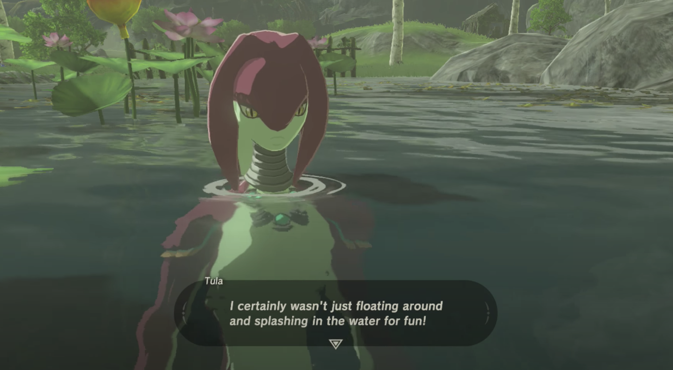
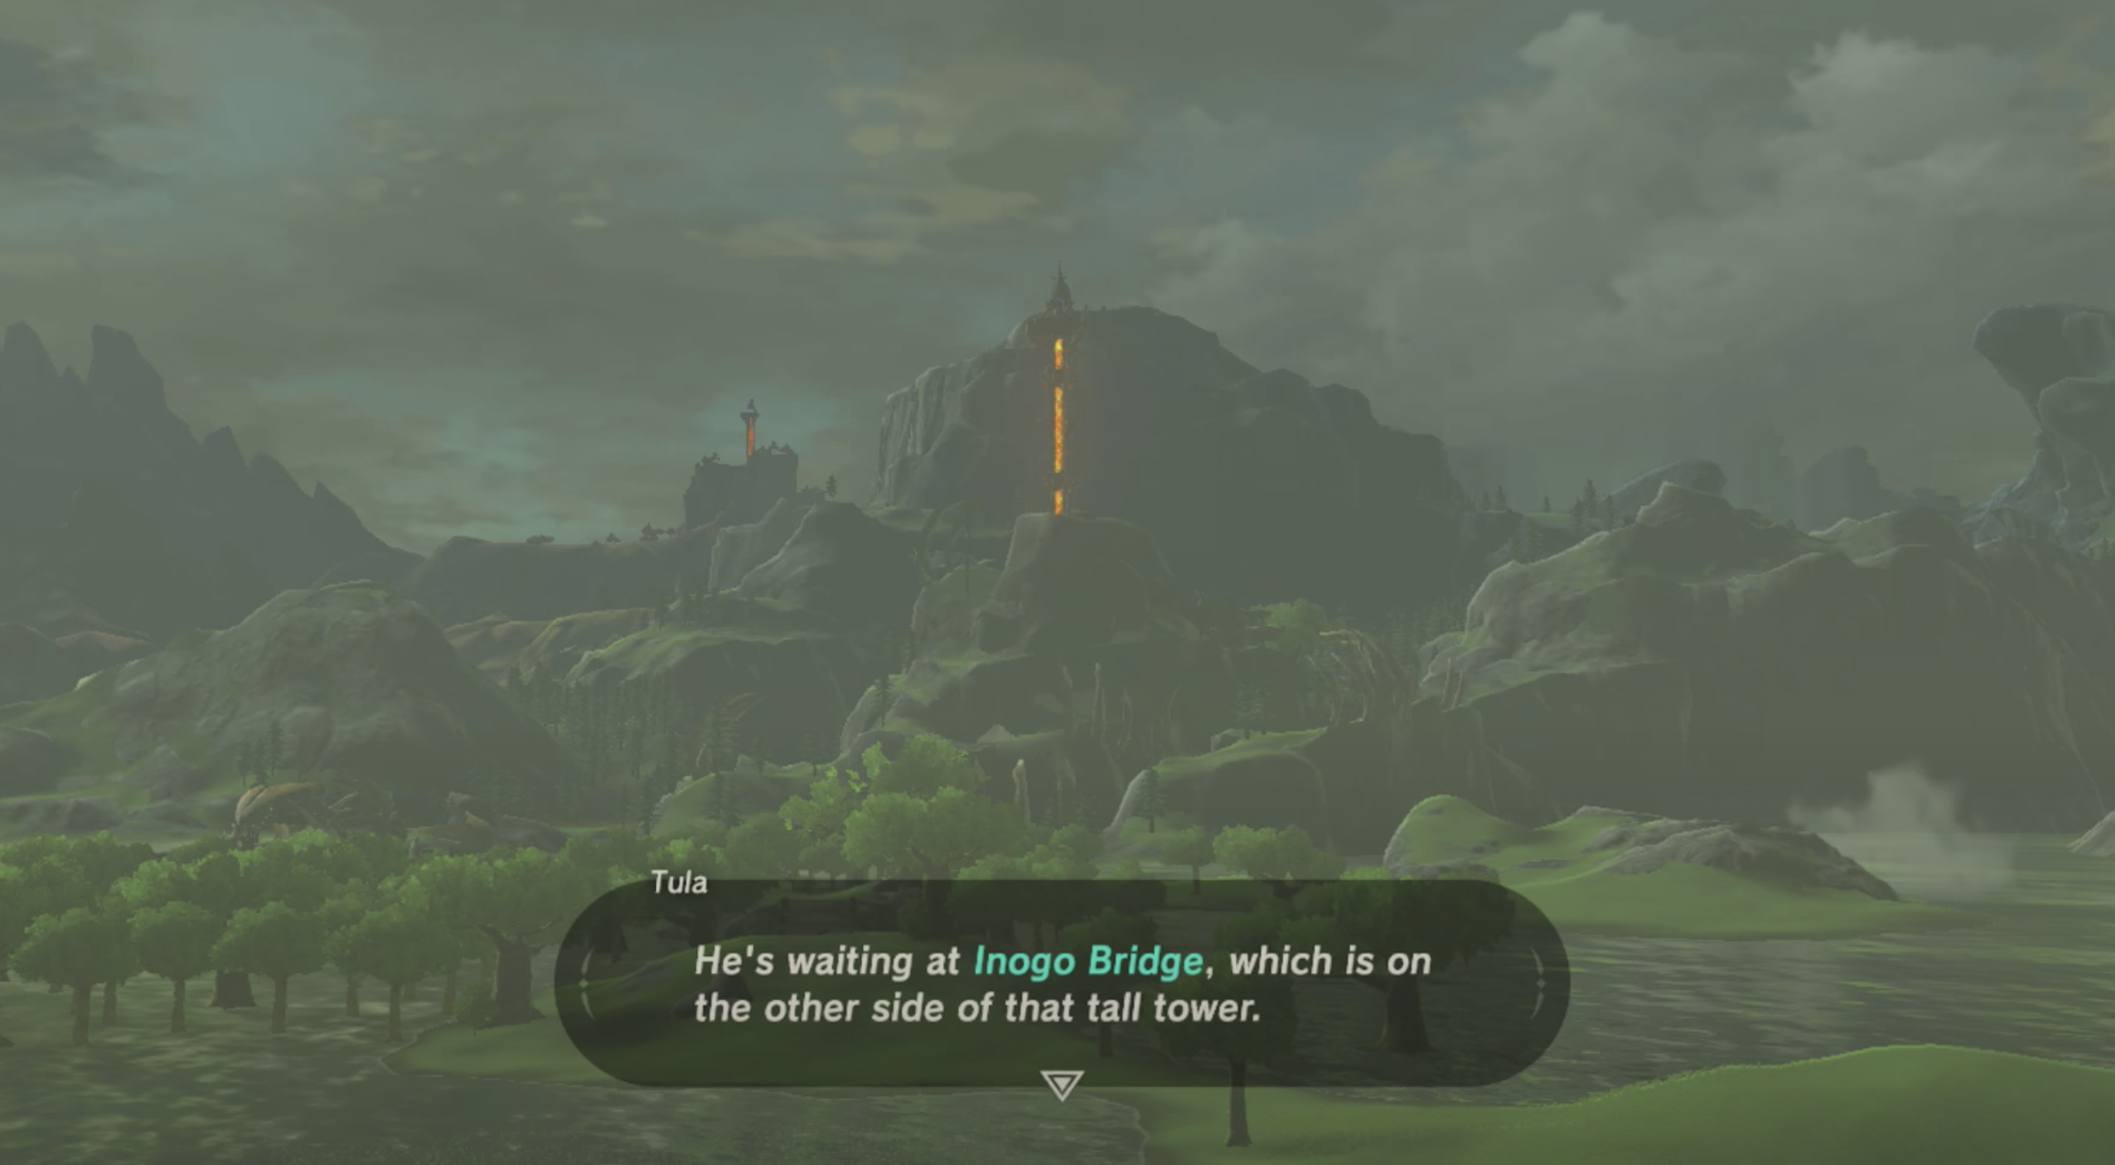
BOTW
4. Cutscenes to push player towards major goal

Slide 33
Summary
Level Design:
Think about players, tutorials, and how to guide. Could be soft guidance, gated by PCs or power-ups, gated by geographic layout, or just give player everything in a small sandbox and grow complexity of levels.
When possible though, try to teach players how to play through examples, visuals, etc.

